Slide 1
Mastering Number
Reception
Term 3
Week 21
Focus: Cardinality, ordinality and counting

Slide 2
Session 3
Mastering Number 2021/22 ncetm.org.uk

Slide 3
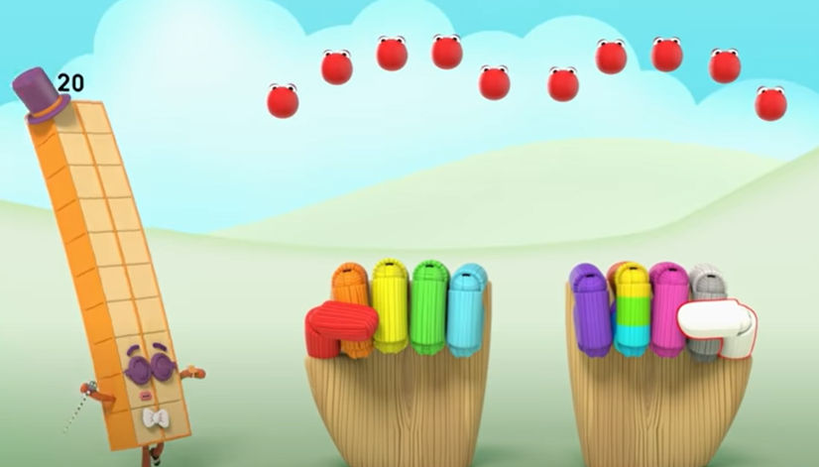
Numberblocks Series 4, Episode 14: I Can Count to Twenty
Video © 2021 Alphablocks Ltd. All rights reserved. Mastering Number 2021/22 ncetm.org.uk

Slide 4
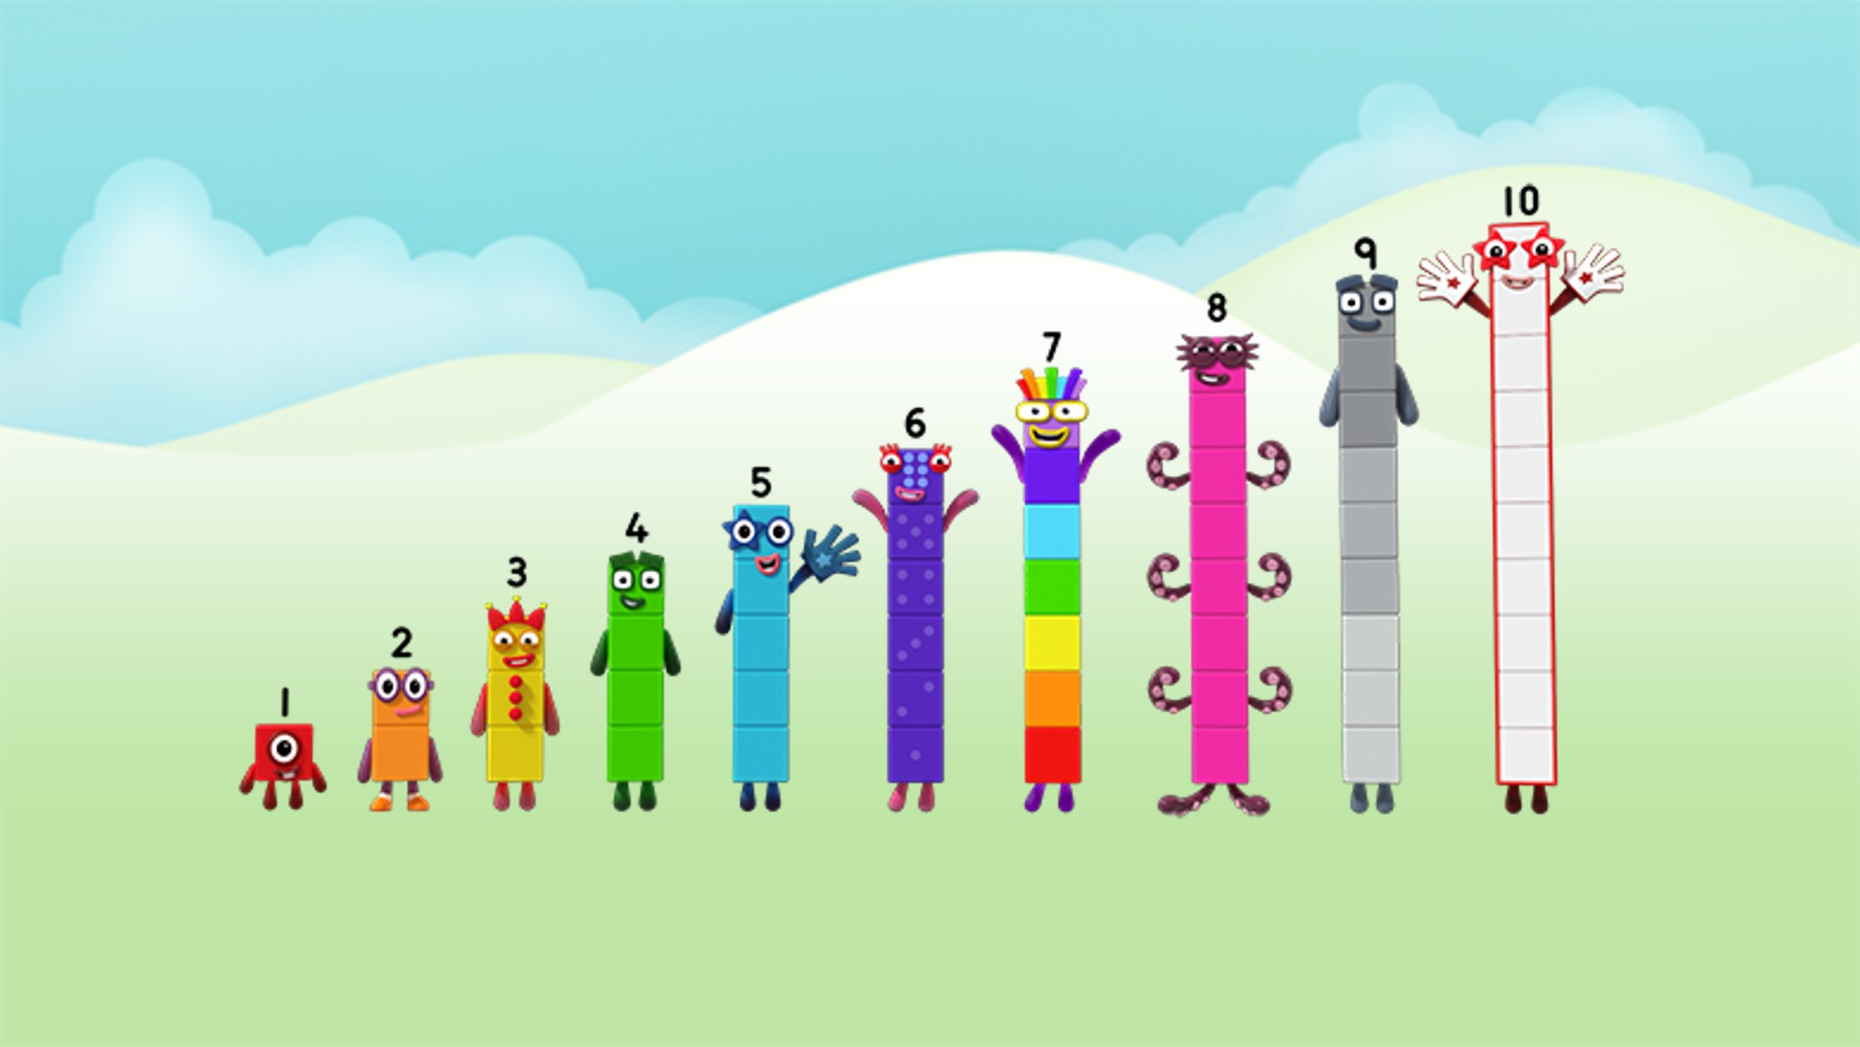
Can you count to 20?
Image © 2021 Alphablocks Ltd. All rights reserved. Mastering Number 2021/22 ncetm.org.uk

Slide 5
Images © 2021 Alphablocks Ltd. All rights reserved. Mastering Number 2021/22 ncetm.org.uk

Slide 6
Session 4
Mastering Number 2021/22 ncetm.org.uk

Slide 7
Mastering Number 2021/22 ncetm.org.uk

Slide 8
Mastering Number 2021/22 ncetm.org.uk

